Slide 2
Pipetting for electrophoresis
03

Slide 3
Teacher notes: Session contents
Practising micropipetting | 15 min | The importance of being able to dispense small quantities accurately into context and supporting learning how to use a micropipette.
Exploring gel electrophoresis | 35 min | A brief introduction to gel electrophoresis and how to load a gel. Developing skills in gel electrophoresis using dye samples.
Interpreting gel electrophoresis | 08 min | Application of knowledge about electrophoresis to interpret the results of gel electrophoresis of dyes.
Collecting samples | 02 min | A reminder that samples need to be collected prior to the next session.

Slide 4
Pipetting for electrophoresis
Practising micropipetting
Exploring gel electrophoresis
Collecting samples
Interpreting gel electrophoresis

Slide 5
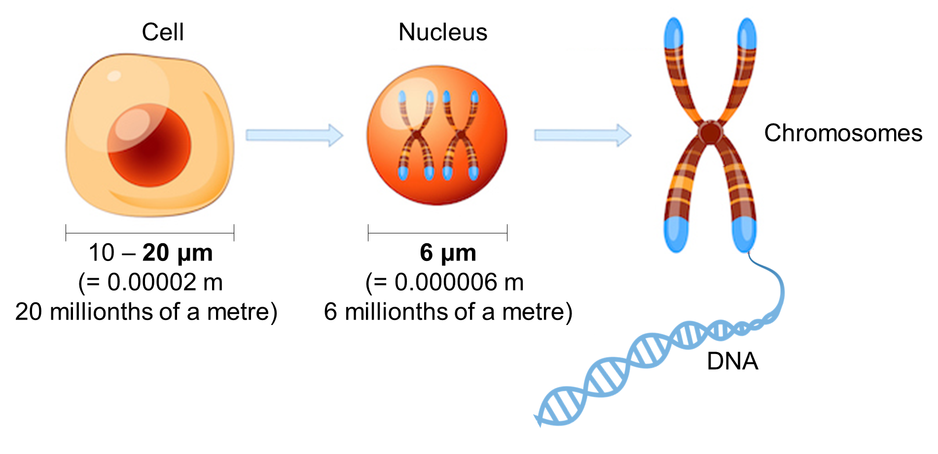
Practising micropipetting
Molecular biology involves working with very small samples of material.
Notes:
Locate DNA within the cell with increasing precision
Start to relate to size
A typical animal cell is 10–20 μm in diameter, which is about one-fifth the size of the smallest particle visible to the naked eye.
Info from: https://www.ncbi.nlm.nih.gov/books/NBK26880/#:~:text=A%20typical%20animal%20cell%20is,visible%20to%20the%20naked%20eye.
The nucleus diameter is about 6 μm

Slide 6
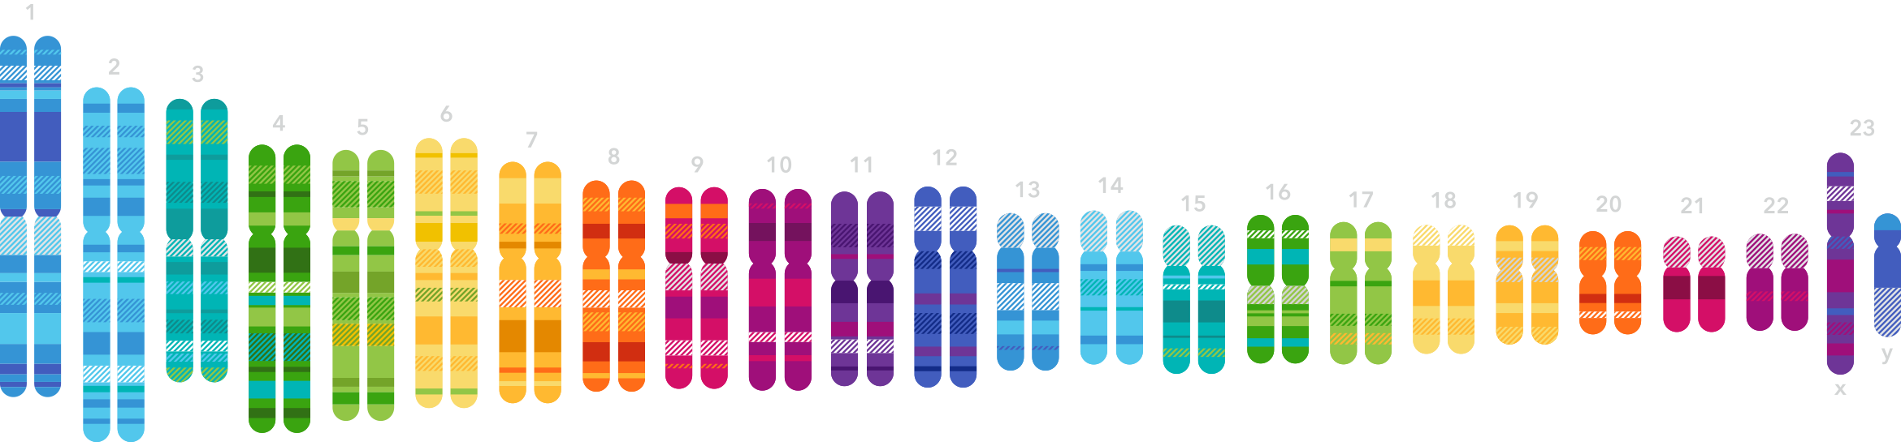
Practising micropipetting
DNA is a very important, but very small molecule.
The DNA from one human body cell (a human genome) is:
~ 2 metres long
~ 2.5 nm wide (0.0000000025 metres)
~ 6 picograms of DNA (0.000000000006 g)
Notes:
For additional interest a female genome is 2.08 m, whilst a male human genome if 2.05 m due to the difference in length of the X / Y chromosomes
For comparison a human hair is 100,000 nm wide
DNA is 2.5 nm wide
So DNA is 1/ 40,000th of the width of a human hair
Human somatic cells contain about 6 picograms of DNA (6 x 10⁻¹² gram)

Slide 7
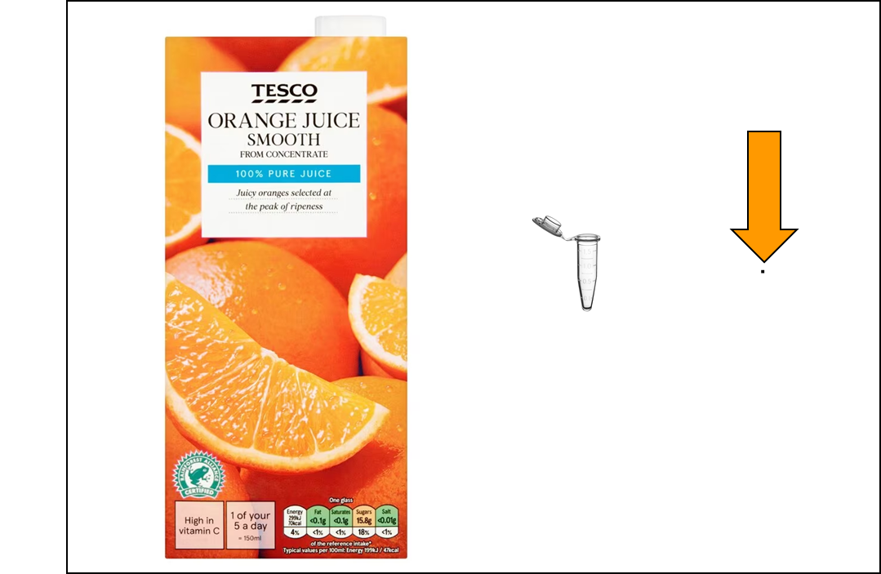
Practising micropipetting
Working with very small molecules, like DNA, means small samples, and requires accurate measurement of very small quantities.
DNA samples are commonly used in microlitre volumes. To give an idea of how small this is, the diagram shows:
1 litre of orange juice
1 millilitre (ml) in a tube = 1 x 10⁻³ litre
1 microlitre (µl) in a dot = 1 x 10⁻⁶ litre
Notes:
Size comparison allowing a recap of standard form and the 1,000 fold difference in volume

Slide 8
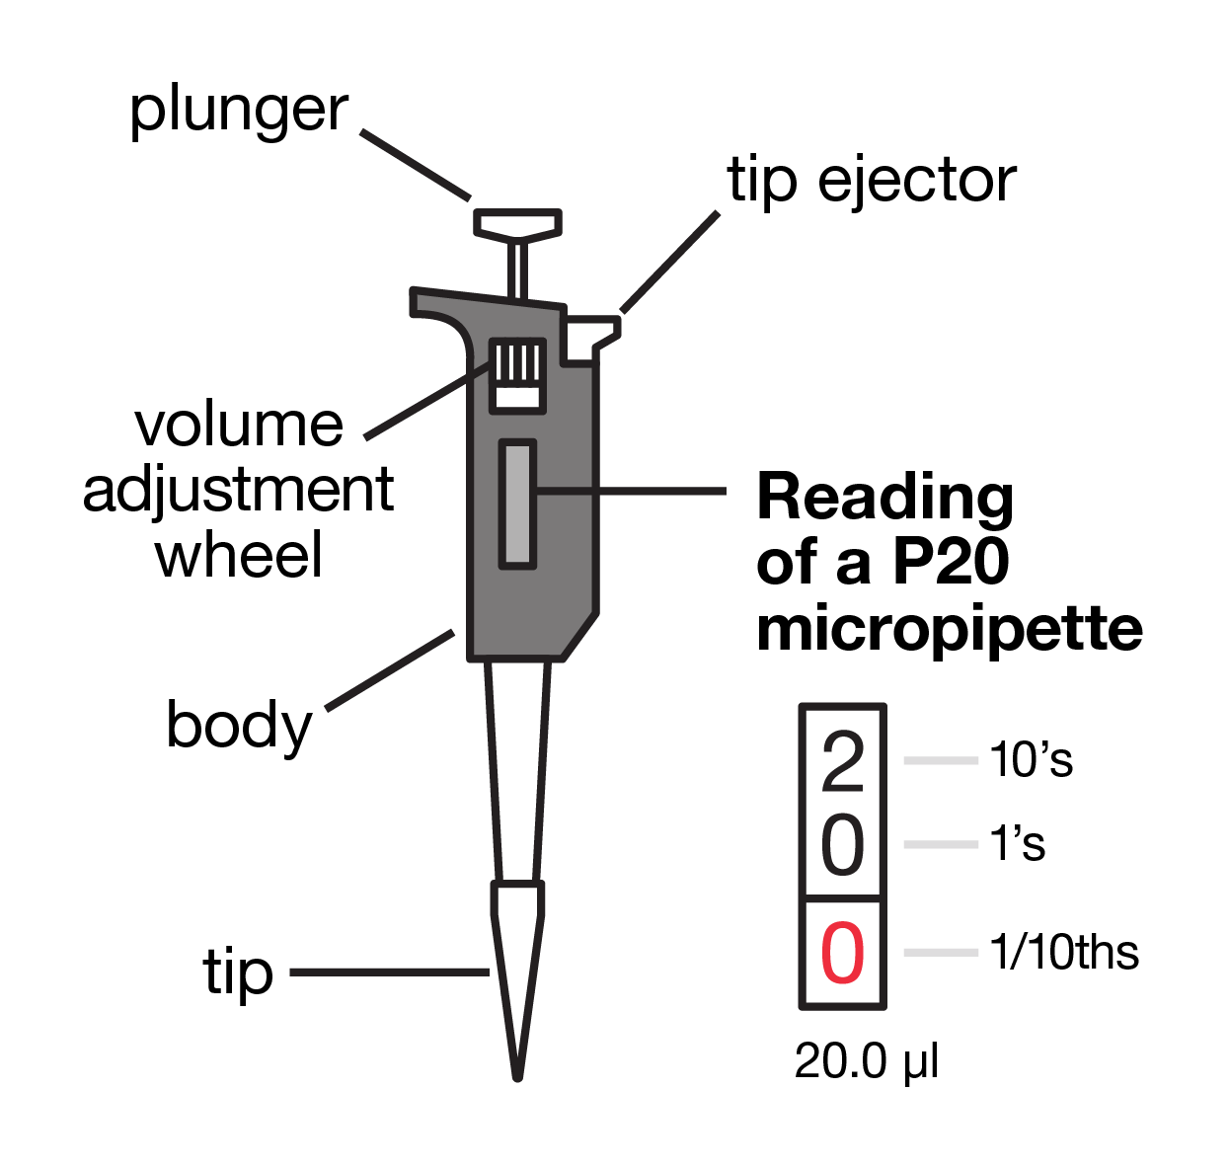
Practising micropipetting
A micropipette is used to dispense small volumes accurately.
Notes:
Introducing the beautiful micropipette

Slide 9
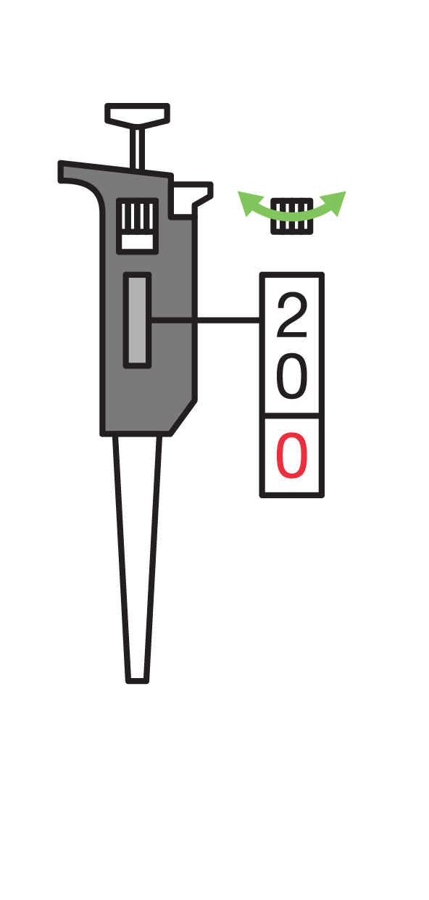
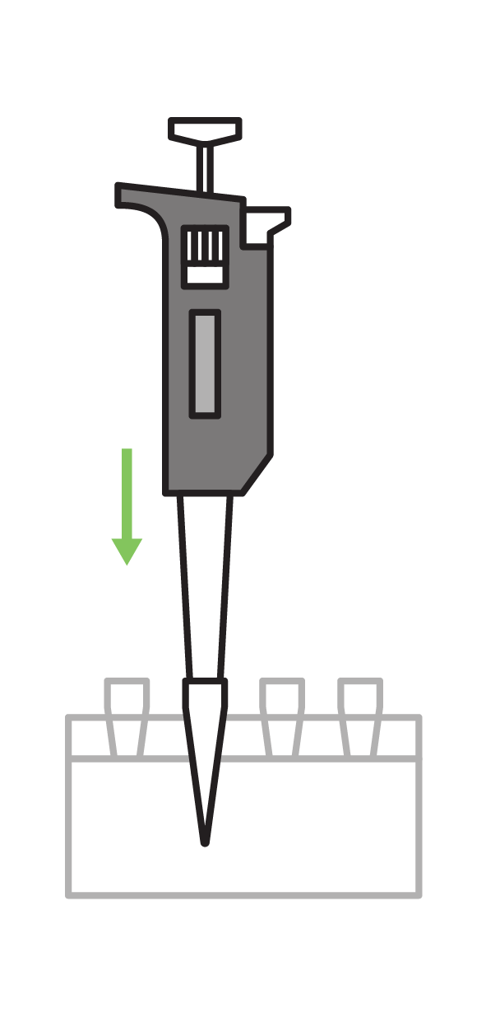
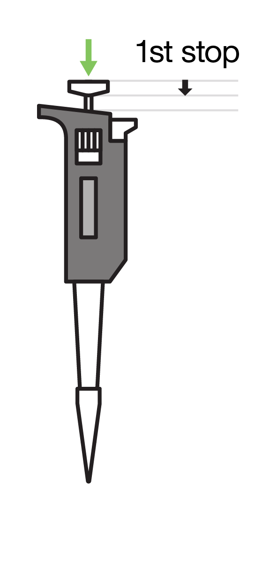
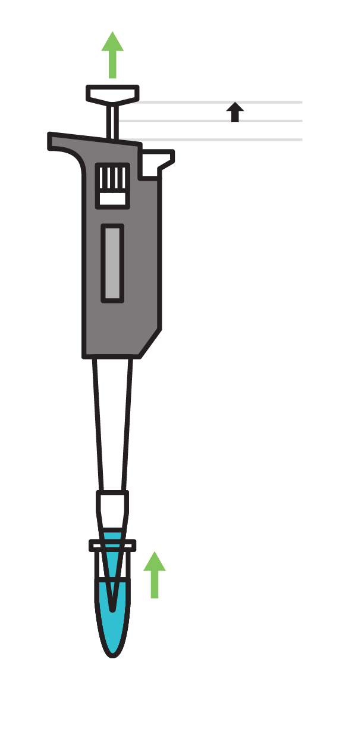
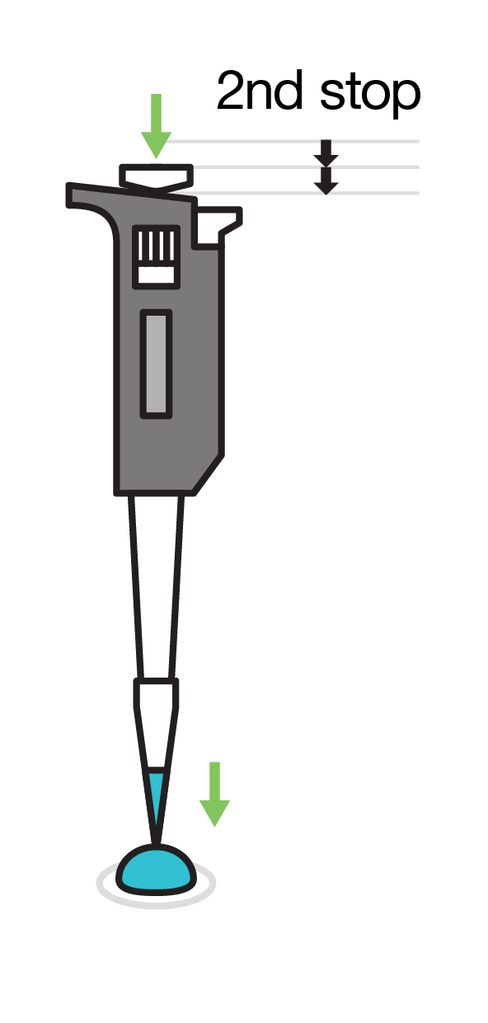
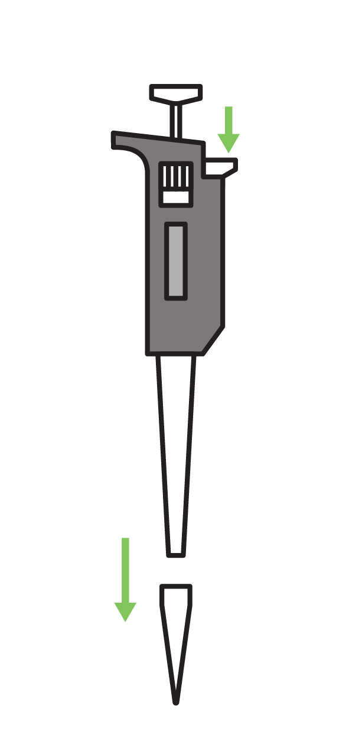
Practising micropipetting
To use a micropipette:
Set the volume
Put on the tip
Press plunger to first resistance
Insert tip into solution
Slowly release plunger
Place tip ready to dispense
Press and hold plunger right down
Remove tip from liquid
Release plunger
Eject tip

Slide 10
Practising micropipetting

Slide 11
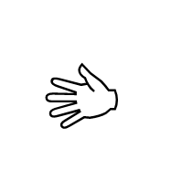
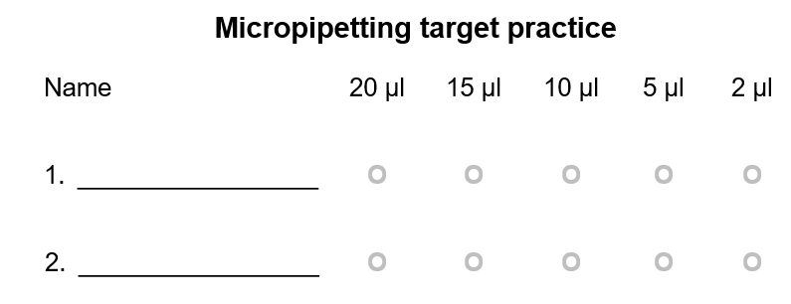
Practising micropipetting
Use the micropipette to accurately dispense the liquid labelled FD onto the laminated micropipetting target practice sheet in the volumes shown.

Slide 12
Pipetting for electrophoresis
Practising micropipetting
Exploring gel electrophoresis
Collecting samples
Interpreting gel electrophoresis

Slide 13
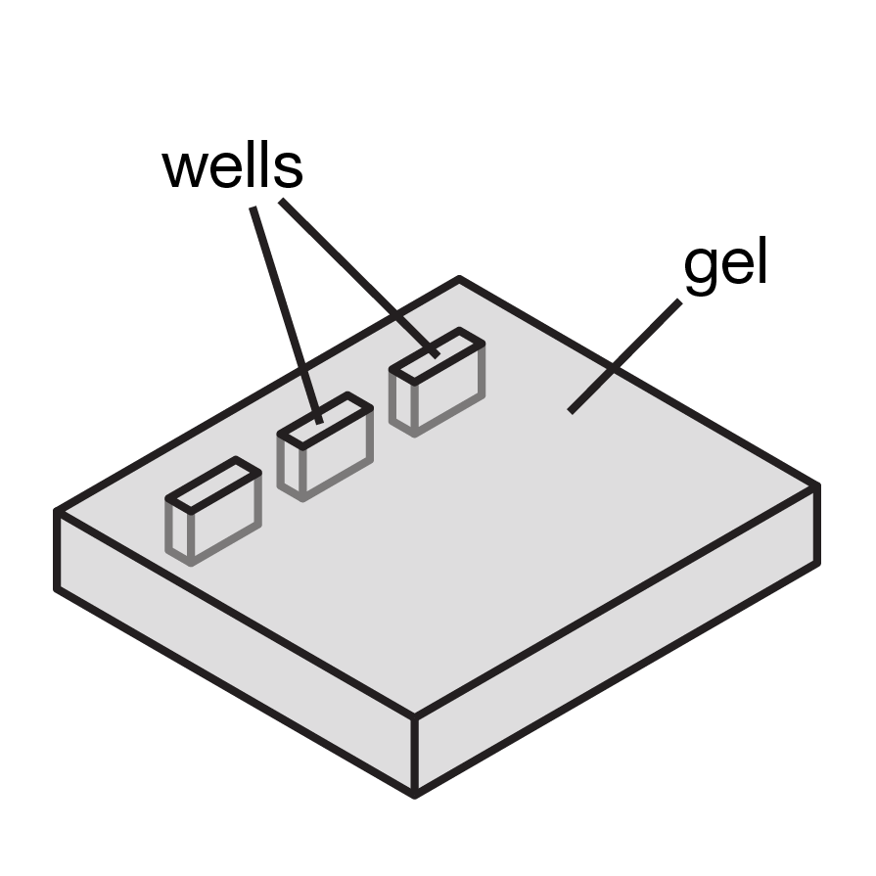
Exploring gel electrophoresis
Agarose gel electrophoresis allows separation of a mixture of biomolecules (often DNA) by size.
An agarose gel is a slab of jelly, which acts like a molecular sieve, with wells (pocket-like holes that go partway through the gel) that samples are loaded into.
Electrophoresis is the use of an electrical current to move the biomolecules through the agarose gel. DNA is negatively charged, so it moves toward the positive electrode.

Slide 14
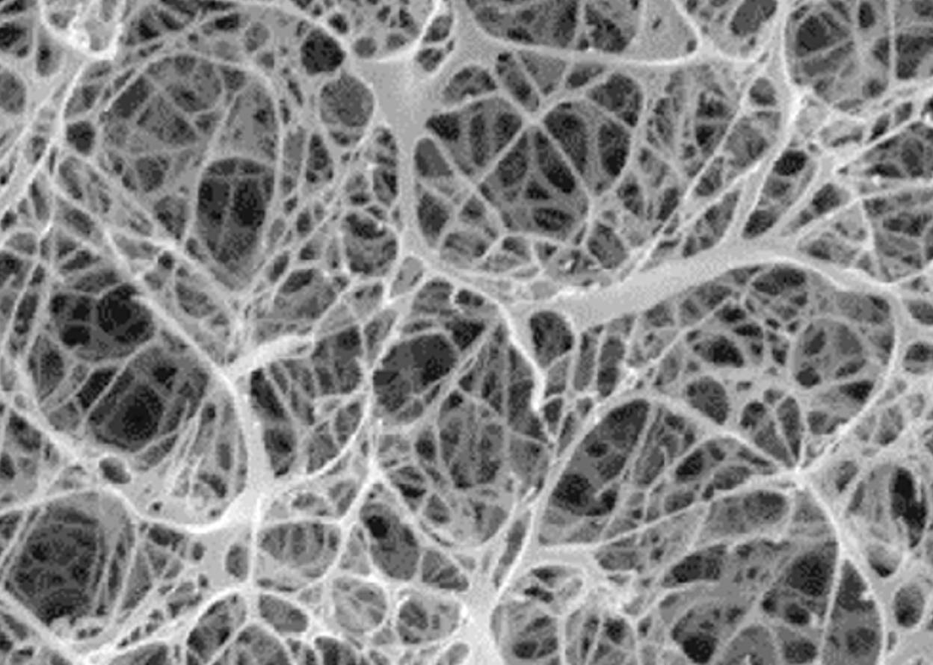
Exploring gel electrophoresis
The agarose gel matrix is visible under a scanning electron microscope.
The rate at which molecules can move through the tunnel-like matrix depends on:
size - smaller molecules move more rapidly
electrical charge – molecules with greater charge to mass ratio move more rapidly
shape – compact molecules move more rapidly
Image credit: MiniPCR
(https://www.minipcr.com/choosing-the-right-agarose-percentage/)
Notes:
SEM of agarose from MiniPCR

Slide 15
Exploring gel electrophoresis
The primary factor affecting movement through an agarose gel by electrophoresis is size.
Direction of electrical current
Agarose gel
Well containing biomolecules
Notes:
Which coloured molecule is the smallest? Red
Which coloured molecule is the largest? Blue
Which coloured molecule went the furthest? Red
Which coloured molecule went least distance? Blue

Slide 16
Exploring gel electrophoresis
Gels can determine the number and relative size of biomolecules in several samples at once.
Direction of electrical current
Agarose gel
Well containing biomolecules
Notes:
Note there are 4 wells in this representation.
Which well contained the largest number of biomolecules? Well 4 (numbering from top to bottom of slide – it has 6 biomolecules)
Which well contained the smallest number of biomolecules? Wells 1, 2 and 3 all have 2 biomolecules
Which well contained the smallest biomolecule? Well 2 (numbering from top to bottom of slide)
Which well contained the largest biomolecule? Well 4 (numbering from top to bottom of slide)

Slide 17
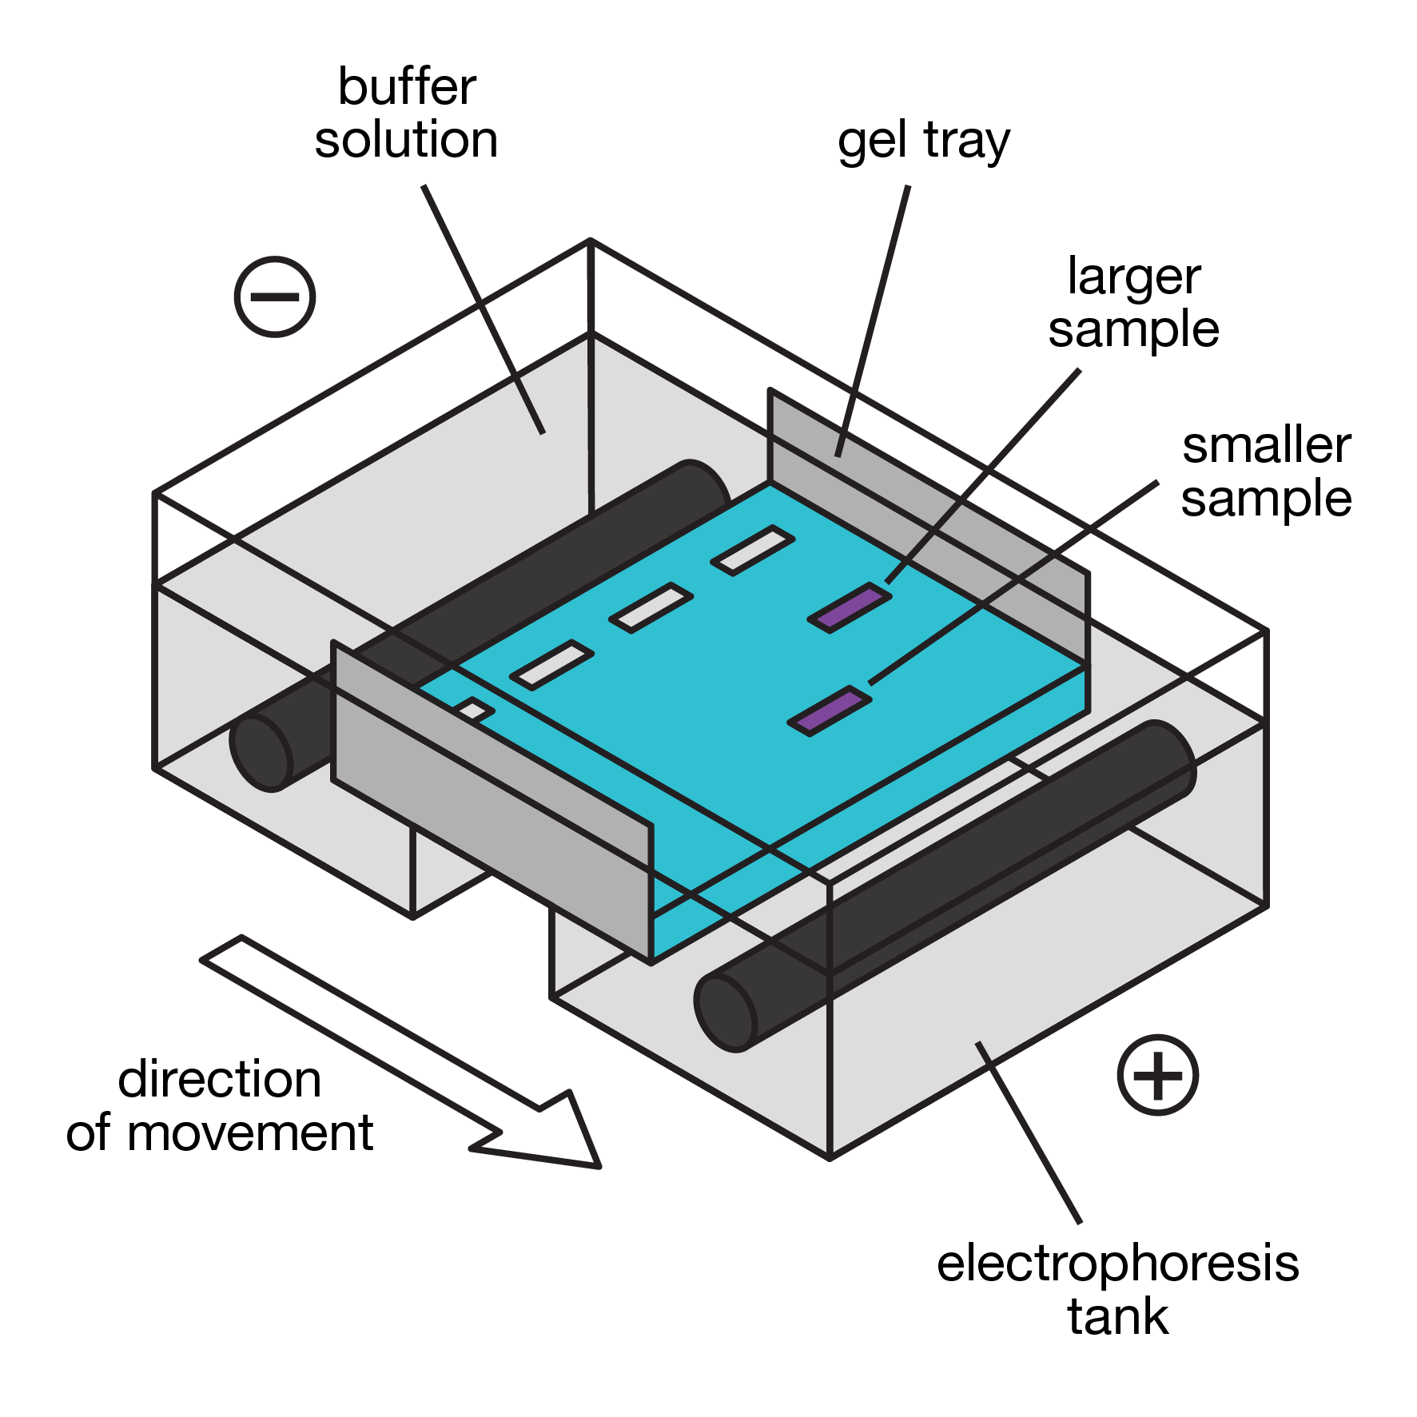
Exploring gel electrophoresis
Before performing electrophoresis, you should put on gloves and safety glasses.
4 dye solutions are provided
The agarose gel is in the electrophoresis tank ready for use

Slide 18
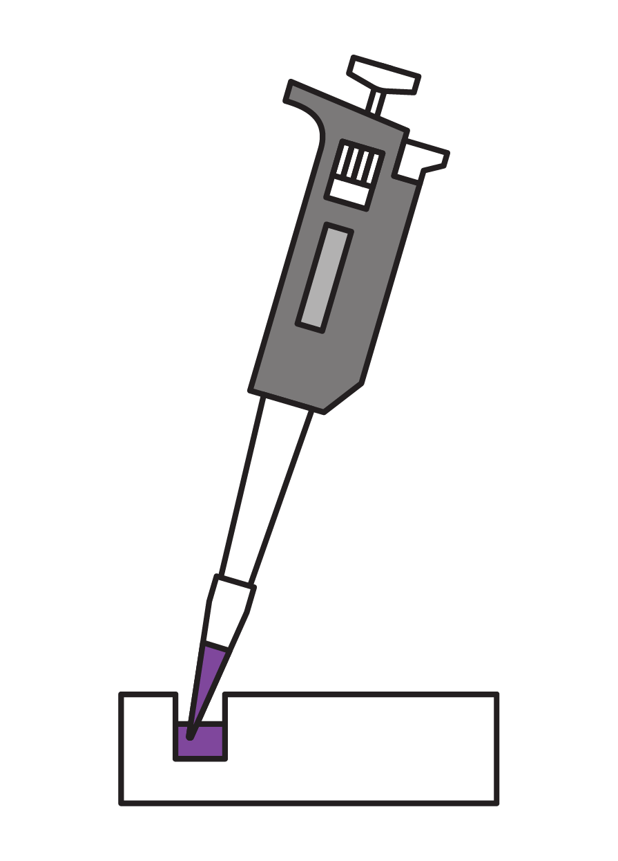
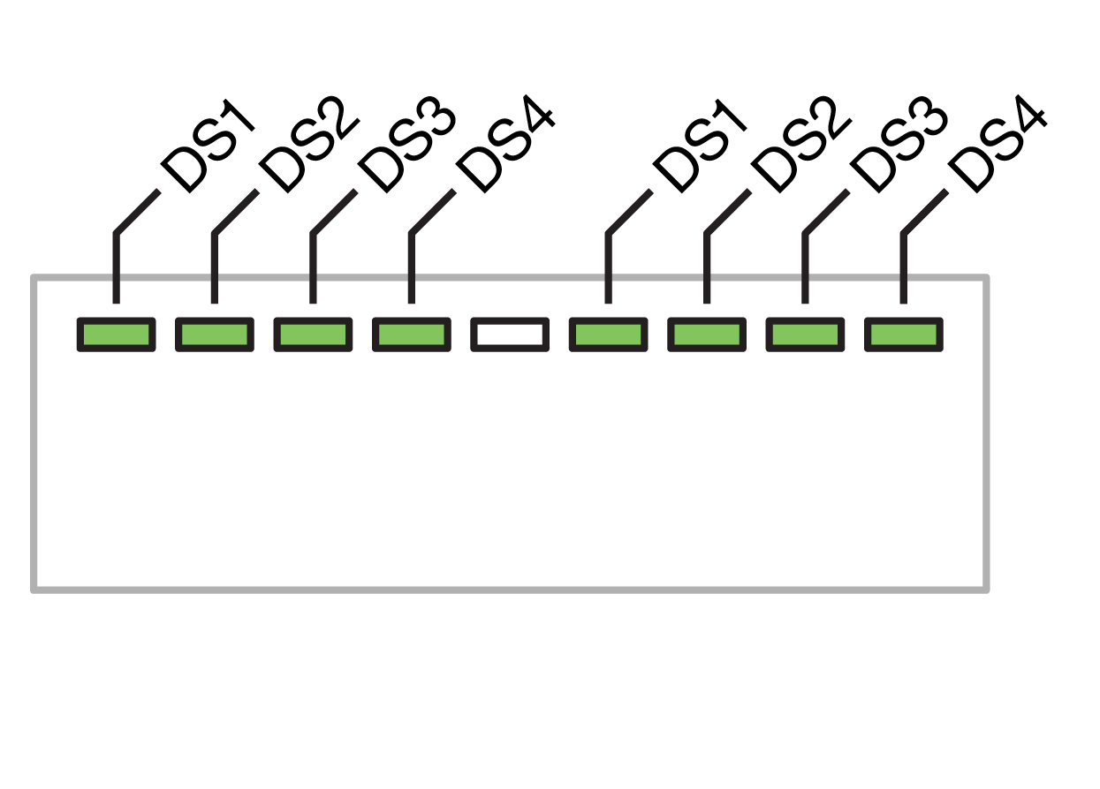
Exploring gel electrophoresis
Before performing electrophoresis, you should put on gloves and safety glasses.
Load 10 µl of dye solutions into a well, following the instructions
* Don’t put the tip into the well, the samples have greater density than the buffer, so will sink into the well
Each person should load 1 sample
When the gel is loaded, place the orange lid on and press the power button to start electrophoresis
Start a timer for 20 minutes

Slide 19
Pipetting for electrophoresis
Practising micropipetting
Exploring gel electrophoresis
Collecting samples
Interpreting gel electrophoresis

Slide 20
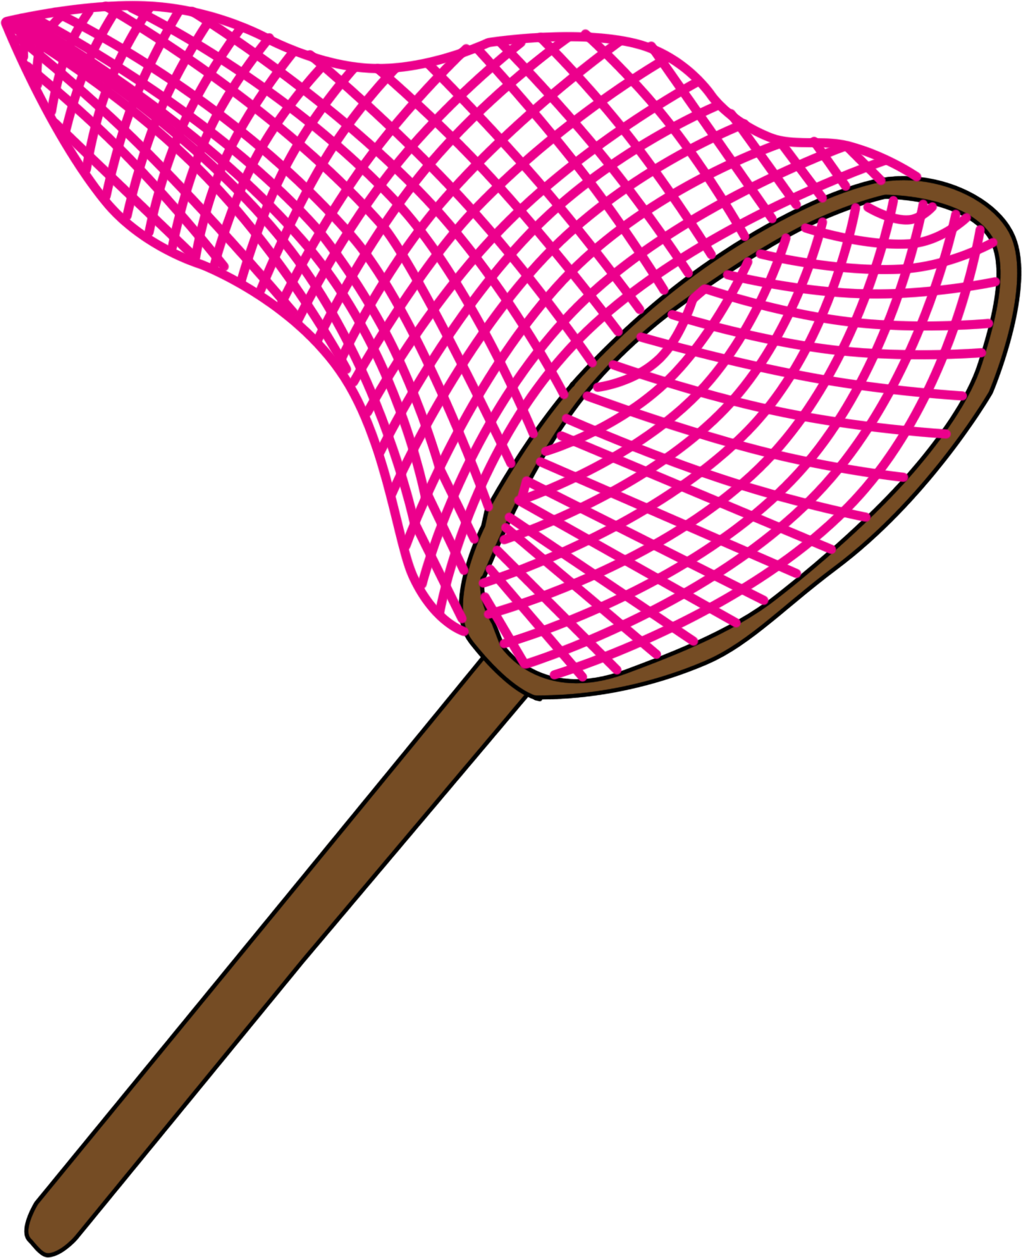
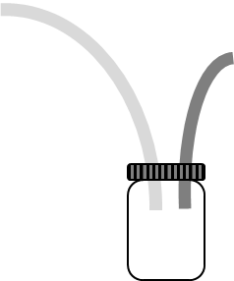
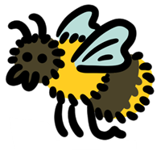
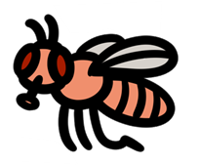
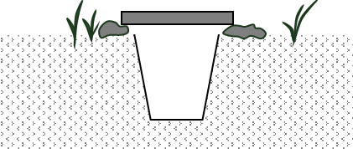
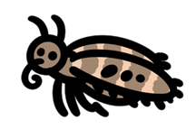
Collecting samples
You will need your invertebrate next session for use in your project.
The sample needs to be fresh (not more than 2 days old)
Choose and use an appropriate method to collect your invertebrate
Place your sample in a Ziplock bag
Label the bag with your initials
Place the Ziplock bag in a -20°C freezer

Slide 21
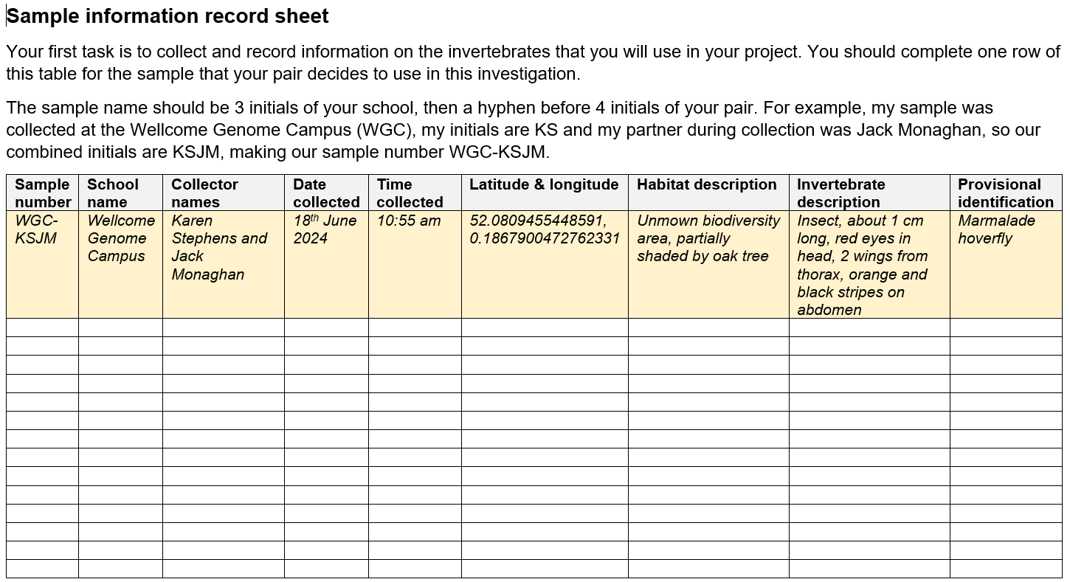
Collecting samples
As well as collecting an invertebrate, you need to record information on the specimen that you will use, so another scientist could check the reproducibility of your results.
Take a photo of your invertebrate sample
Find the sample information record sheet in a file named ’02_R_Sample-information-record-sheet’
Complete the sample information record sheet (using the example to help you)
You need this information next session.

Notes:
Notes:
Store the photo of your invertebrate somewhere you will be bale to find it again!
Please use the standardised method of naming samples and ensure that there aren’t 2 samples with the same sample name
Google Maps will give co-ordinates for a location, as will any device with GPS
The Field Study Council guides are helpful in preliminary identification of invertebrates

Slide 22
Pipetting for electrophoresis
Practising micropipetting
Exploring gel electrophoresis
Collecting samples
Interpreting gel electrophoresis

Slide 23
Interpreting gel electrophoresis
When 20 minutes have passed, unplug the electrophoresis tank at the socket
One person for each tank should put on gloves and safety glasses.
This person should carefully lift the gel out of the buffer and onto a white piece of paper
Other people from the group should take a photograph of the results for analysis
The person in gloves and safety glasses should then place the gel into the autoclave bag and empty the buffer from the gel carriage into the sink, rinsing it with plenty of water

Slide 24
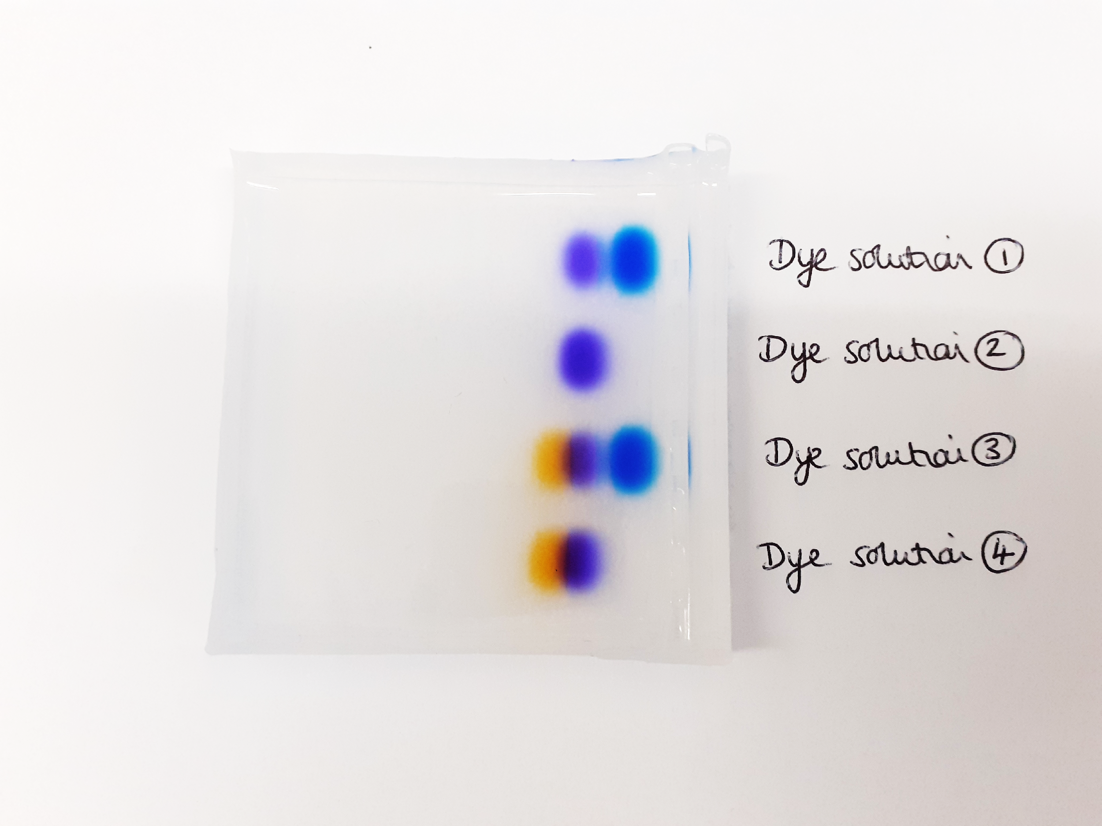
Interpreting gel electrophoresis

Using the photo of the gel answer the questions:
A. Which dye solution contains only one dye?
B. Which dye solutions contain 2 dyes?
C. Which dye solution contains 3 dyes?
Dye solution 1
Dye solution 2
Dye solution 2.
Dye solution 3
Dye solutions 1 and 4.
Dye solution 4
Dye solution 3.

Slide 25
Interpreting gel electrophoresis

Using the photo of the gel answer the questions:
D. What electrical charge do the dyes have?
How do you know?
Dye solution 1
Dye solution 2
Negative.
Dye solution 3
In an electrical field they move towards the positive electrode.
Dye solution 4

Slide 26
Interpreting gel electrophoresis
The purple dye is bromophenol blue.
The light blue dye is xylene cyanol.
The orange dye is Orange G.
Use the photo of the gel and information above to answer the question:
E. From your gel electrophoresis results, put the dyes into size order from largest to smallest. Explain your reasoning.
Dye solution 1
Dye solution 2

Dye solution 3
Dye solution 4
Light blue (xylene cyanol), purple (bromophenol blue), orange (Orange G)
Xylene cyanol has moved least distance, so is the largest, whilst Orange G has moved the furthest, so is the smallest.

Slide 27
Interpreting gel electrophoresis
The purple bromophenol blue has molecular weight 669.98 au.
The light blue xylene cyanol has molecular weight 538.62 au.
The orange, Orange G has molecular weight 452.38 au.
F. How do these weights compare with your original conclusions about the sizes of the dye molecules?
Dye solution 1
Dye solution 2
Dye solution 3
Dye solution 4
The light blue dye (xylene cyanol) and purple dye (bromophenol blue) are the opposite way around compared to expectations. They have not separated based on size alone.
Notes:
EXTENSION work for A level students

Slide 28
Interpreting gel electrophoresis
G. What factors other than molecular weight may have played a role in the separation of these dyes by electrophoresis?
Dye solution 1
Charge and shape.
Whilst larger molecules will move less distance than smaller molecules if both have the same charge, molecules with more negative charge will move faster than molecules with less negative charge if both have the same weight.
Dye solution 2
Dye solution 3
Dye solution 4
Despite, xylene cyanole (538.62 au) having a smaller size than bromophenol blue (669.98 au) it migrates more slowly than bromophenol blue because xylene cyanole has a smaller charge to mass ratio.
Notes:
EXTENSION work for A level students

Slide 29
Pipetting for electrophoresis
Practising micropipetting
Exploring gel electrophoresis
Collecting samples
Interpreting gel electrophoresis
Next session we be extracting DNA from your invertebrate samples.
Remember to have your sample ready.

Slide 30
Thank you
Barcoding for beginners is a project by Wellcome Connecting Science, funded by a Royal Society Partnership grant.
All resources can be found on YourGenome: yourgenome.org/theme/barcoding-for-beginners
Image credits Wellcome Connecting Science Insect illustrations: Petra Korlević

